Slide 1
Introduction
Barings was a bank founded in 1762 and was Britain’s oldest merchant bank and Queen Elizabeth’s personal bank.
Barings was the bank that fund the Napoleon Wars, Louisiana Purchase and the Erie Canal.

Slide 2
Nick Leeson
Nick Leeson was hired by Barings to profit from low risk arbitrage opportunities between derivatives contract
He was in control of the back and front office functions. Until his exploits of falsified documents and false profits that cause $1.4 billion of losses for the company found out.

Slide 3
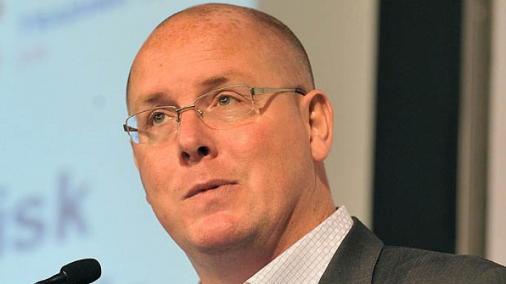
Leeson Pictured in 2011
Notes:
After released from jail, he works as a head division in Debt Advisory company, Northern Ireland, where he is supported by a team of property, accountancy, legal and banking professionals. he frequently gives speech about his “success”, and paid really well for it, 6k poundsterling.

Slide 4
Question 1
What are Ethics? Generally, why do people act unethically?

Slide 5
Definition of Ethics
Ethics can be defined broadly as a set of moral principles or values. Each of us has such a set of values, although we may or may not have considered them explicitly.
Examples of prescribed sets of moral principles or values at the implementation level include laws and regulations, church doctrine, codes of business ethics for professional groups such as auditors, and codes of conduct & ethics within individual organisations.
Notes:
moral principle - The principles of right and wrong that are accepted by an individual or a social group.
values - Important and lasting beliefs or ideals shared by the members of a culture about what is good or bad and desirable or undesirable.

Slide 6
Unethical Behavior
Unethical behavior is conduct that differs from what they believe is appropriate during the circumstances.
Each of us decides for ourselves what we consider unethical behavior both for ourselves and others, because each person have their own ethical standard.

Slide 7
Unethical Behavior
There are two main reasons why people act unethically:
The person’s ethical standards are different from those of society as whole.
The person chooses to act selfishly.

Slide 8
Person’s Ethical Standards Differ From General
In this case, Lee Neson start hiding company loses and sacrifice his company well being for his personal gain, while he knew what he did was fraud, and still do it anyway. It can be said that Neeson ethical standard differ from other.
It can be said that Neeson ethical standards differ from other.

Slide 9
The Person Chooses to Act Selfishly
When Neeson generating very unusual amount of money, Baring Bank management chose to ignore where are all the money come. Because when the company generating huge amount of profit they will get big bonus as well, which of course will benefit them.
It can be said that Baring Bank management chooses to act selfishly.

